Slide 1

Week # 9
Operations Research
(Software Engineering)

Slide 2
Transportation model
The transportation problem deals with the distribution of goods from several points of supply (sources) to a number of points of demand (destinations)
Usually we are given the capacity of goods at each source and the requirements at each destination
Typically the objective is to minimize total transportation and production costs

Slide 3
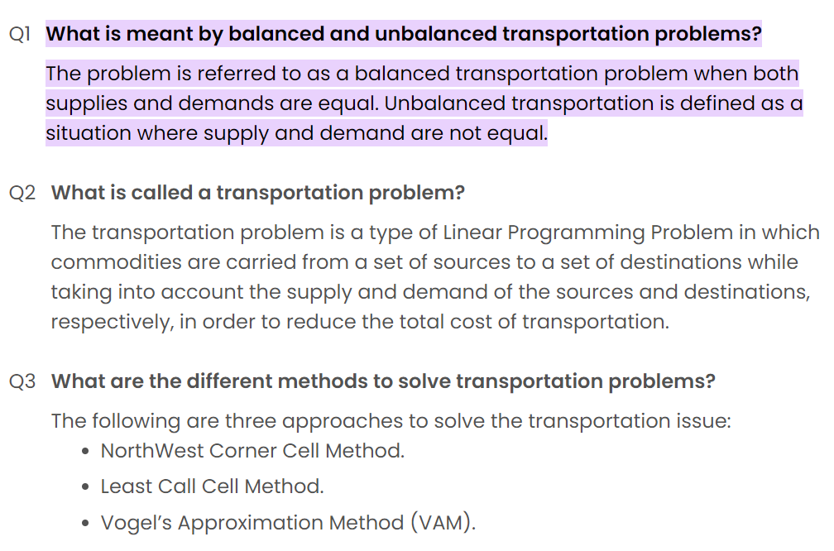

Slide 4
Obtain an initial basic feasible solution
Following three different methods are discussed to obtain an initial solution:
North-West Corner Method,
Least Cost Method, and
Vogel’s Approximation (or Penalty) Method.
The initial solution obtained by any of the three methods must satisfy the following conditions:
(i) The solution must be feasible, i.e. it must satisfy all the supply and demand constraints (also called rim conditions).
(ii) The number of positive allocations must be equal to m + n – 1, where m is the number of rows and n is the number of columns of the cost table.
Any solution that satisfies the above conditions is called non-degenerate basic feasible solution, otherwise, degenerate solution.

Slide 5
North west cost method (Procedure)
First we check the problem is balance or unbalance. If supply equal demands then the problem is balance otherwise unbalance.
The unbalanced transportation problem can be made balanced by adding a dummy supply centre (row) or a dummy demand centre (column) as the need arises.
Select the top left corner cell (box) of the transportation problem and allocates as many unit as possible equal to the minimum between available supply and demand.
Adjust the supply and demand number in the respective rows and column.
If the demand for the first cell is satisfied then move horizontally to the next cell in the second column.

Slide 6
North west cost method (Procedure)
If the supply for the first cell is satisfied then move down in the second row.
If demand is satisfied then delete (×) the column.
If supply is satisfied then delete (×) the row.
Continue the process until all supply and demand are satisfied.

Slide 7
Example 1:
Karachi and Lahore factories are two car supplier factories. The transportation cost per car to transport from Karachi to Peshawar, Sialkot, and Multan is 13, 11, and 40 thousand, respectively. The transportation cost per car to transport from Lahore to Peshawar, Sialkot, and Multan is 18, 18, and 12 thousand, respectively. However, Karachi can only supply a maximum of 2 cars per month in total and Lahore can only supply a maximum of 7 cars per month in total. The cities Peshawar, Sialkot, and Multan have monthly demand of 1, 3, and 5 cars, respectively. Determine the cost per month for supplying these cars. Use North-West Corner Method (NWCM) to find an initial basic feasible solution.

Slide 8
North west cost method (NWCM)
TO FROM | Peshawar |  | Sialkot |  | Multan |  | FACTORY CAPACITY/Supply
Karachi | 13 |  | 11 |  | 40 |  | 2
Lahore | 18 |  | 18 |  | 12 |  | 7
Requirement/ Demand | 1 |  | 3 |  | 5

Slide 9

Initial basic feasible solution
The unbalanced transportation problem can be made balanced by adding a dummy supply centre (row) or a dummy demand centre (column) as the need arises.
Rim condition: m+n-1$≥$ 0, where m = no of rows,
n=no of columns.
The rim condition ensures that the problem is balanced and has enough constraints to uniquely determine the solution.
Here m=2, n=3,
m+n-1=2+3-1=4

Slide 10
North west cost method
TO FROM | Peshawar |  | Sialkot |  | Multan |  | FACTORY CAPACITY/Supply
Karachi | 13 | 1 | 11 |  | 40 |  | 2-1=1
Lahore | 18 |  | 18 |  | 12 |  | 7
Requirement/ Demand | 1-1=0 |  | 3 |  | 5

Slide 11
North west cost method
TO FROM | Sialkot |  | Multan |  | FACTORY CAPACITY/Supply
Karachi | 11 |  | 40 |  | 1
Lahore | 18 |  | 12 |  | 7
Requirement/ Demand | 3 |  | 5

Slide 12
North west cost method
TO FROM | Sialkot |  | Multan |  | FACTORY CAPACITY/Supply
Karachi | 11 | 1 | 40 |  | 1-1=0
Lahore | 18 |  | 12 |  | 7
Requirement/ Demand | 3-1=2 |  | 5

Slide 13
North west cost method
TO FROM | Sialkot |  | Multan |  | FACTORY CAPACITY/Supply
Lahore | 18 |  | 12 |  | 7
Requirement/ Demand | 2 |  | 5

Slide 14
North west cost method
TO FROM | Sialkot |  | Multan |  | FACTORY CAPACITY/Supply
Lahore | 18 | 2 | 12 |  | 7-2=5
Requirement/ Demand | 2-2=0 |  | 5

Slide 15
North west cost method
TO FROM | Multan |  | FACTORY CAPACITY/Supply
Lahore | 12 |  | 5
Requirement/ Demand | 5

Slide 16
North west cost method
TO FROM | Multan |  | FACTORY CAPACITY/Supply
Lahore | 12 | 5 | 5-5=0
Requirement/ Demand | 5-5=0

Slide 17

North west cost method
TO FROM | Peshawar |  | Sialkot |  | Multan |  | FACTORY CAPACITY/Supply
Karachi | 13 | 1 | 11 | 1 | 40 |  | 2
Lahore | 18 |  | 18 | 2 | 12 | 5 | 7
Requirement/ Demand | 1 |  | 3 |  | 5
$Total Cost=$13$×1+11×1+18×2+12×5$
=13+11+36+60
=120 thousand

Slide 18
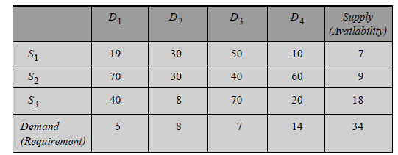
A company has three production facilities S1, S2 and S3 with production capacity of 7, 9 and 18 units (in 100s) per week of a product, respectively. These units are to be shipped to four warehouses D1, D2, D3 and D4 with requirement of 5, 6, 7 and 14 units (in 100s) per week, respectively. The transportation costs (in rupees) per unit between factories to warehouses are given in the table below. Minimize the total transportation cost.

Slide 19
Least cost method (procedure)
First of all we check the problem is balance or unbalance.
Identify the box having minimum unit transportation cost
If the minimum cost is not unique then choose top left box or where maximum allocation can be made.
Choose the value from the corresponding demand or supply, where the value is less.
Repeat the above steps until all restrictions are satisfied.

Slide 20
Least Cost Method
TO FROM | Peshawar |  | Sialkot |  | Multan |  | FACTORY CAPACITY/Supply
Karachi | 13 |  | 11 |  | 40 |  | 2
Lahore | 18 |  | 18 |  | 12 |  | 7
Requirement/ Demand | 1 |  | 3 |  | 5

Slide 21
Initial basic feasible solution
m+n-1,
Where m = no of rows,
n=no of columns,
m=2,
n=3,
m+n-1=2+3-1=4

Slide 22
Least Cost Method
TO FROM | Peshawar |  | Sialkot |  | Multan |  | FACTORY CAPACITY/Supply
Karachi | 13 |  | 11 |  | 40 |  | 2
Lahore | 18 |  | 18 |  | 12 |  | 7
Requirement/ Demand | 1 |  | 3 |  | 5

Slide 23
Least Cost Method
TO FROM | Peshawar |  | Sialkot |  | Multan |  | FACTORY CAPACITY/Supply
Karachi | 13 |  | 11 | 2 | 40 |  | 2-2=0
Lahore | 18 |  | 18 |  | 12 |  | 7
Requirement/ Demand | 1 |  | 3-2=1 |  | 5

Slide 24
Least Cost Method
TO FROM | Peshawar |  | Sialkot |  | Multan |  | FACTORY CAPACITY/Supply
Karachi | 13 |  | 11 | 2 | 40 |  | 0
Lahore | 18 |  | 18 |  | 12 |  | 7
Requirement/ Demand | 1 |  | 1 |  | 5

Slide 25
Least Cost Method
TO FROM | Peshawar |  | Sialkot |  | Multan |  | FACTORY CAPACITY/Supply
Lahore | 18 |  | 18 |  | 12 |  | 7
Requirement/ Demand | 1 |  | 1 |  | 5

Slide 26
Least Cost Method
TO FROM | Peshawar |  | Sialkot |  | Multan |  | FACTORY CAPACITY/Supply
Lahore | 18 |  | 18 |  | 12 | 5 | 7-5=2
Requirement/ Demand | 1 |  | 1 |  | 5-5=0

Slide 27
Least Cost Method
TO FROM | Peshawar |  | Sialkot |  | Multan |  | FACTORY CAPACITY/Supply
Lahore | 18 |  | 18 |  | 12 | 5 | 2
Requirement/ Demand | 1 |  | 1 |  | 0

Slide 28
Least Cost Method
TO FROM | Peshawar |  | Sialkot |  | FACTORY CAPACITY/Supply
Lahore | 18 | 1 | 18 |  | 2-1=1
Requirement/ Demand | 1-1=0 |  | 1

Slide 29
Least Cost Method
TO FROM | Peshawar |  | Sialkot |  | FACTORY CAPACITY/Supply
Lahore | 18 | 1 | 18 |  | 1
Requirement/ Demand | 0 |  | 1

Slide 30
Least Cost Method
TO FROM | Sialkot |  | FACTORY CAPACITY/Supply
Lahore | 18 | 1 | 1-1=0
Requirement/ Demand | 1-1=0

Slide 31
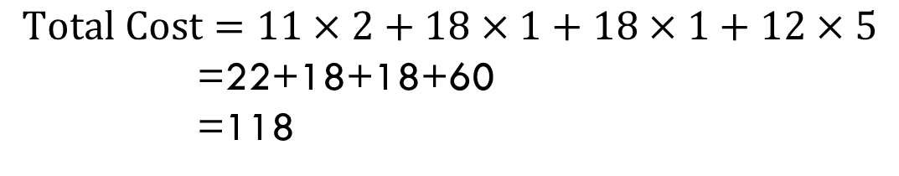
Least Cost Method
TO FROM | Peshawar |  | Sialkot |  | Multan |  | FACTORY CAPACITY/Supply
Karachi | 13 | 1 | 11 | 2 | 40 |  | 2
Lahore | 18 | 1 | 18 | 1 | 12 | 5 | 7
Requirement/ Demand | 1 |  | 3 |  | 5
$$Total Cost=11×2+18×1+18×1+12×5$$
=22+18+18+60
=118

Slide 32
Vogel’s Approximation (procedure)
First of all, we check our problem is balance or unbalance.
Identify the boxes having minimum and next to minimum transportation cost in each row or column and write the difference (penalty) along the side of the table against the corresponding row and column
Identify the maximum penalty, then go to the minimum cost in that row or column. Choose the value from the corresponding demand or supply, where the value is less.

Slide 33
Vogel’s Approximation (procedure)
If the penalties corresponding to two or more rows or columns are equal you are at liberty to break the tie arbitrarily.
Repeat the above steps until all restrictions are satisfied.
Adjust the supply and demand and cross out the satisfied row or column. If a row and a column are satisfied simultaneously, only one of them is crossed out and the remaining row (column) is assigned a zero supply (demand). Any row or column with zero supply or demand should not be used in computing future penalties.

Slide 34
Vogel’s approximation
TO FROM | Peshawar |  | Sialkot |  | Multan |  | FACTORY CAPACITY/Supply
Karachi | 13 |  | 11 |  | 40 |  | 2
Lahore | 18 |  | 18 |  | 12 |  | 7
Requirement/ Demand | 1 |  | 3 |  | 5

Slide 35
Initial basic feasible solution
m+n-1,
Where m = no of rows,
n=no of columns,
m=2,
n=3,
m+n-1=2+3-1=4

Slide 36
Vogel’s approximation
TO FROM | Peshawar |  | Sialkot |  | Multan |  | FACTORY CAPACITY/Supply | Penalty
Karachi | 13 |  | 11 |  | 40 |  | 2 | (2)
Lahore | 18 |  | 18 |  | 12 |  | 7 | (6)
Requirement/ Demand | 1 |  | 3 |  | 5
Penalty | (5) |  | (7) |  | (28)

Slide 37
Vogel’s approximation
TO FROM | Peshawar |  | Sialkot |  | Multan |  | FACTORY CAPACITY/Supply | Penalty
Karachi | 13 |  | 11 |  | 40 |  | 2 | (2)
Lahore | 18 |  | 18 |  | 12 |  | 7 | (6)
Requirement/ Demand | 1 |  | 3 |  | 5
Penalty | (5) |  | (7) |  | (28)

Slide 38
Vogel’s approximation
TO FROM | Peshawar |  | Sialkot |  | Multan |  | FACTORY CAPACITY/Supply | Penalty
Karachi | 13 |  | 11 |  | 40 |  | 2 | (2)
Lahore | 18 |  | 18 |  | 12 | 5 | 7-5=2 | (6)
Requirement/ Demand | 1 |  | 3 |  | 5-5=0
Penalty | (5) |  | (7) |  | (28)

Slide 39
Vogel’s approximation
TO FROM | Peshawar |  | Sialkot |  | Multan |  | FACTORY CAPACITY/Supply | Penalty
Karachi | 13 |  | 11 |  | 40 |  | 2 | (2)
Lahore | 18 |  | 18 |  | 12 | 5 | 2 | (6)
Requirement/ Demand | 1 |  | 3 |  | 0
Penalty | (5) |  | (7) |  | (28)

Slide 40
Vogel’s approximation
TO FROM | Peshawar |  | Sialkot |  | FACTORY CAPACITY/Supply | Penalty
Karachi | 13 |  | 11 |  | 2 | (2)
Lahore | 18 |  | 18 |  | 2 | (0)
Requirement/ Demand | 1 |  | 3
Penalty | (5) |  | (7)

Slide 41
Vogel’s approximation
TO FROM | Peshawar |  | Sialkot |  | FACTORY CAPACITY/Supply | Penalty
Karachi | 13 |  | 11 | 2 | 2-2=0 | (2)
Lahore | 18 |  | 18 |  | 2 | (0)
Requirement/ Demand | 1 |  | 3-2=1
Penalty | (5) |  | (7)

Slide 42
Vogel’s approximation
TO FROM | Peshawar |  | Sialkot |  | FACTORY CAPACITY/Supply
Lahore | 18 | 1 | 18 |  | 2-1=1
Requirement/ Demand | 1-1=0 |  | 1

Slide 43
Vogel’s approximation
TO FROM | Sialkot |  | FACTORY CAPACITY/Supply
Lahore | 18 | 1 | 1-1=0
Requirement/ Demand | 1-1=0

Slide 44

Vogel’s approximation
TO FROM | Peshawar |  | Sialkot |  | Multan |  | FACTORY CAPACITY/Supply
Karachi | 13 |  | 11 | 2 | 40 |  | 2
Lahore | 18 | 1 | 18 | 1 | 12 | 5 | 7
Requirement/ Demand | 1 |  | 3 |  | 5
$Total Cost=$11$×$2+18$×1+18×1+12×5$
=22+18+18+60
=118

Slide 45
Task
Given table indicates the cost of the products from the factory 1, 2 and 3 to different whole sales market.
Use the following methods to find out the total cost.
(i). North West Cost Method.
(ii). Least Cost Method.
(iii). Vogel’s Approximation.

Slide 46
task
TO Whole Sale FROM Factory | W1 | W2 | W3 | W4 | Capacity
F1 | 19 | 30 | 50 | 10 | 7
F2 | 70 | 30 | 40 | 60 | 9
F3 | 40 | 8 | 70 | 20 | 18
Requirement | 5 | 8 | 7 | 14 | 34

Slide 47
Task
(i). Total cost of North West Cost Method=1015
(ii). Total cost of Least Cost Method=814
(iii). Total cost of Vogel’s Approximation=779

Slide 48
Task
Consider the word problem for two factories with weekly production of 40 and 20 gadgets. These gadgets must be shipped to three warehouses that have a demand of 25, 10, and 25 units. The cost to ship between each location is known (see the grid below). Now the question is how much the minimal cost of factory is, in doing all this procedure. Apply the above three methods to find the cost.

Slide 49
Remark: Total transportation cost found by VAM is lower than the costs of transportation determined by the NWCR and LCM methods. Therefore, it is of advantage to use this method in order to reduce computational time required to obtain optimum solution.

Slide 50
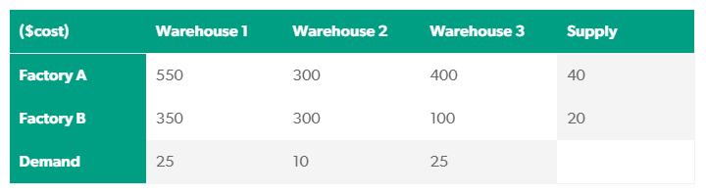
Task

Slide 51
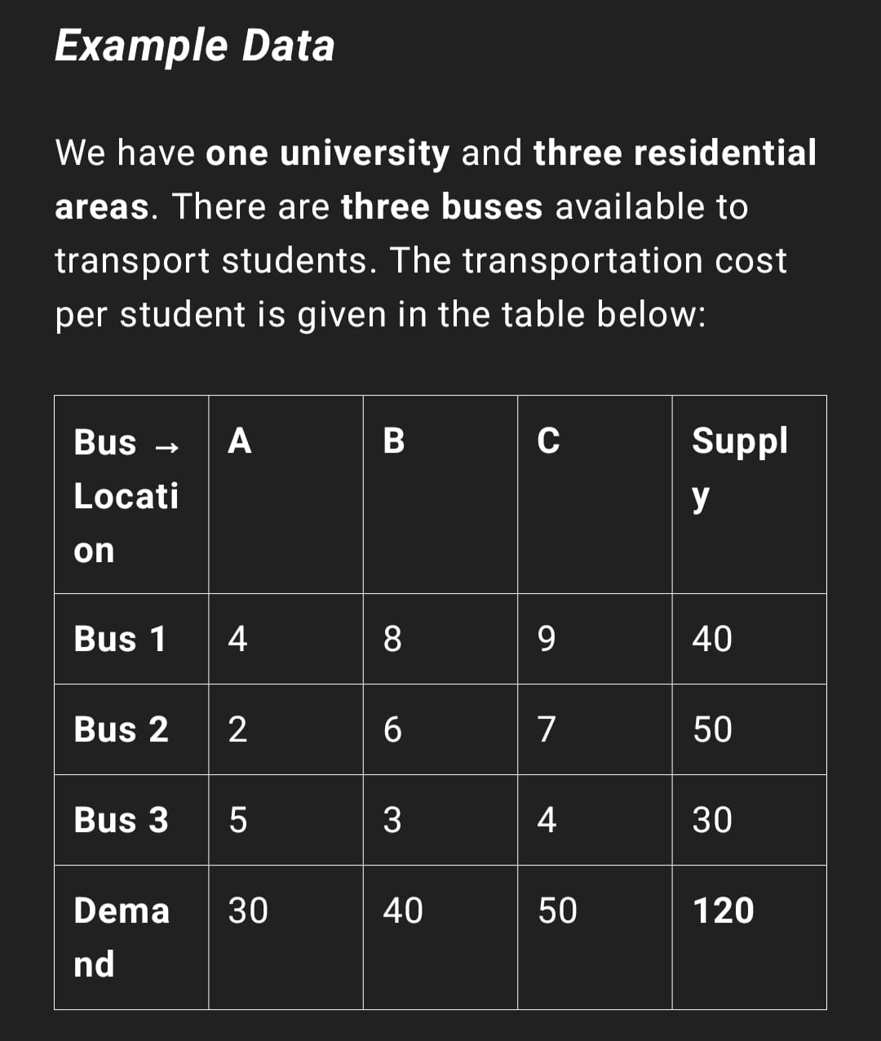

Slide 52
Thank you!

